Slide 1
Multiple translation languages
Shared entities for minority language facilitation

Slide 2
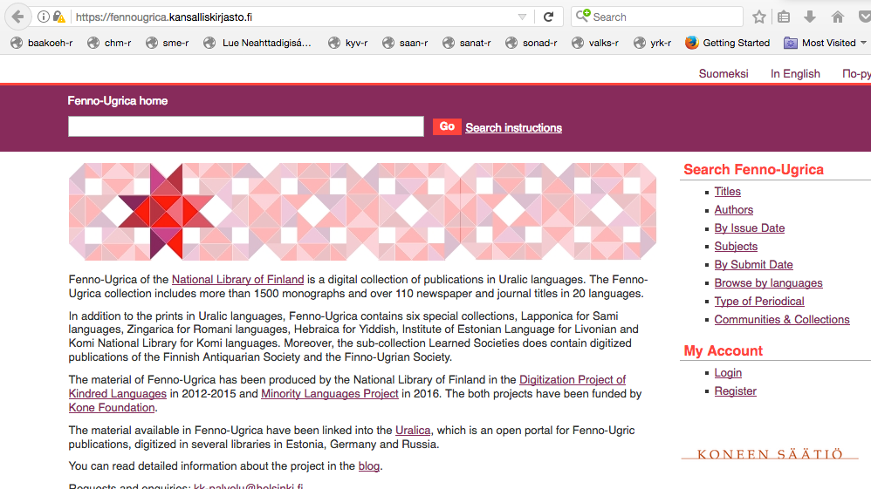
Kone Foundation
Language Programme
Notes:
In 2012 the Kone Foundation launched the “Language Programme”.
Main intent: encourage the retention of Finnish as a language of scientific research,
support the open-source documentation of minority languages,
and secure historic language resources.

Slide 3
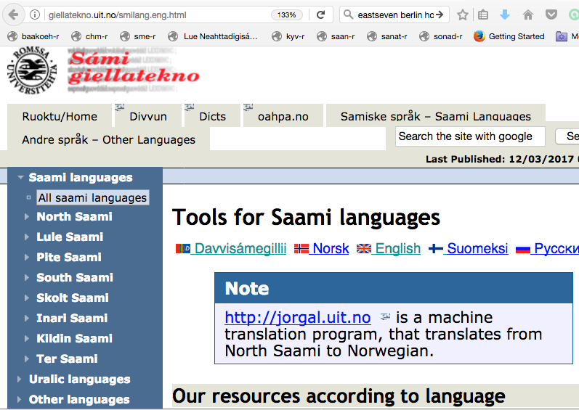
Giellatekno
Sami Language Technology
Notes:
Giellatekno is the open-source Sami language technology infrastructure in Tromsø.
Research and tool development cater to morphologically rich languages,
and multiple reuse of resources.

Slide 4
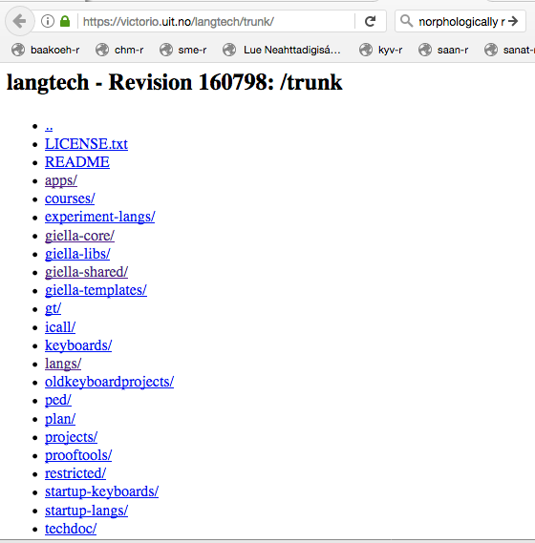
Giellatekno trunk open-source
Notes:
Giellatekno research and tools are open-source.
We work with language-independent strategies for building:
Dictionaries, ICALL, analyzers and spell checkers.

Slide 5
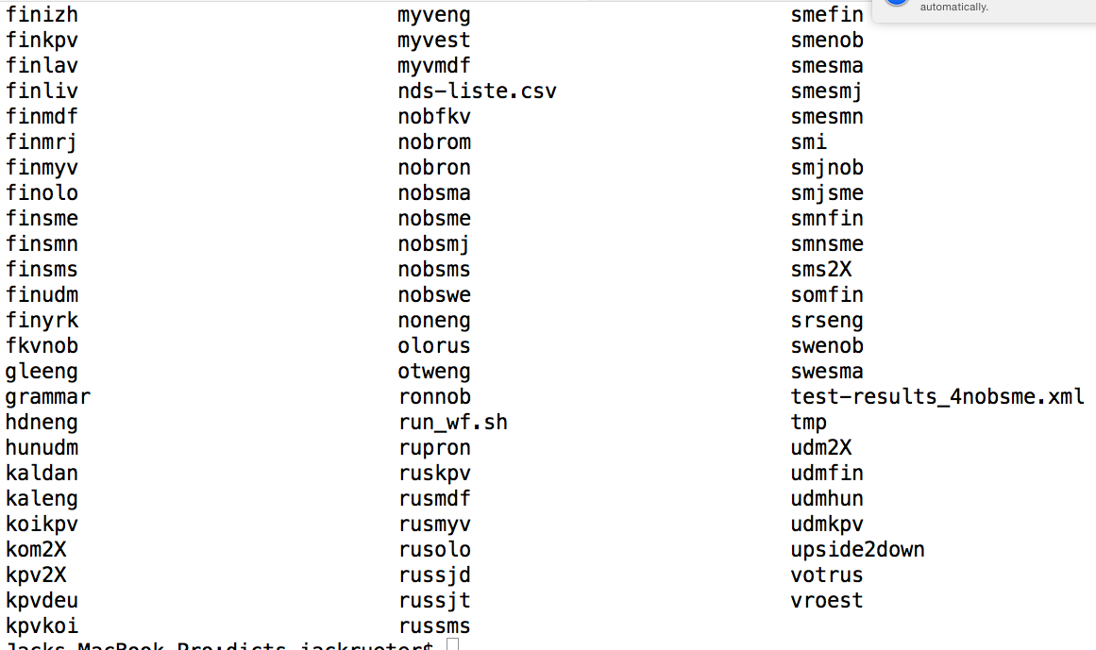
Words and dictionaries
Notes:
Online dictionaries are generally organized for language-pair work.
Morphological transducers for source languages enhance the experience.
There are over 10 dictionary sets for 18 Uralic languages

Slide 6
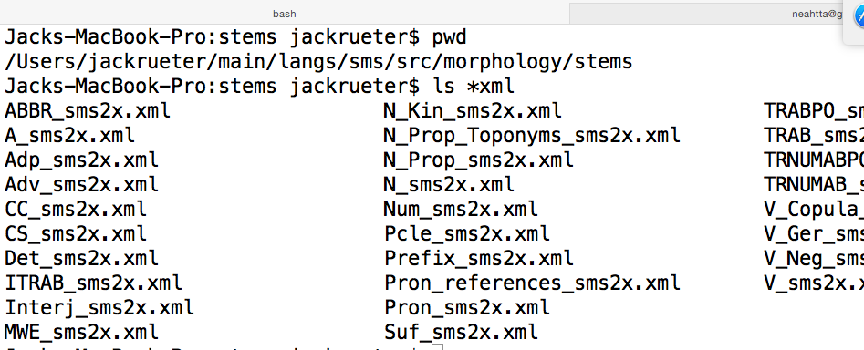
Skolt Sami xml dictionaries for transducer work
Notes:
A number of the transducer projects use xml sources for xsl transformation
These are divided by part-of-speech for morphological purposes.
The same xml files can be used for online dictionaries.

Slide 7
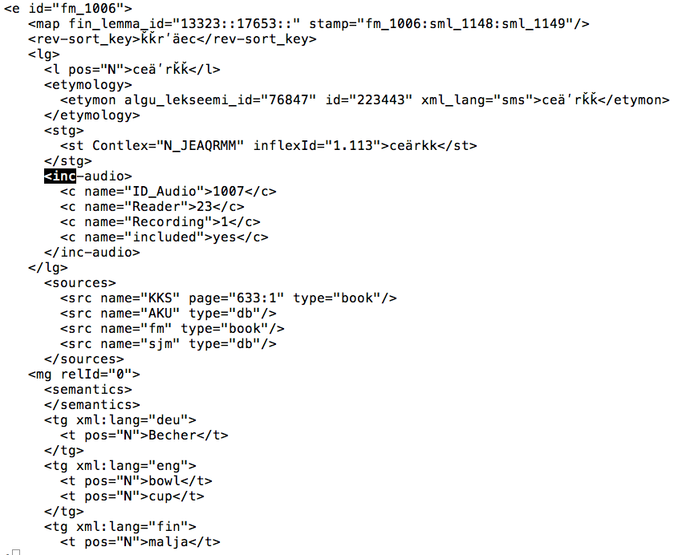
Xml lemma group
Notes:
The dictionary xml is TEI-convertible, hence minimal tag length.
Dictionary work comes from multiple projects, hence the need for mapping.
<lg> for lemma group is for lemmas and stems, as well as etymology, audio and composition.

Slide 8
Xml meaning group
Notes:
<mg> for meaning group is for individuated semantic concepts and translations.
Lemma and stem information are used in our finite-state transducers.
Meaning group info is used with our transducers in online dictionaries.

Slide 9
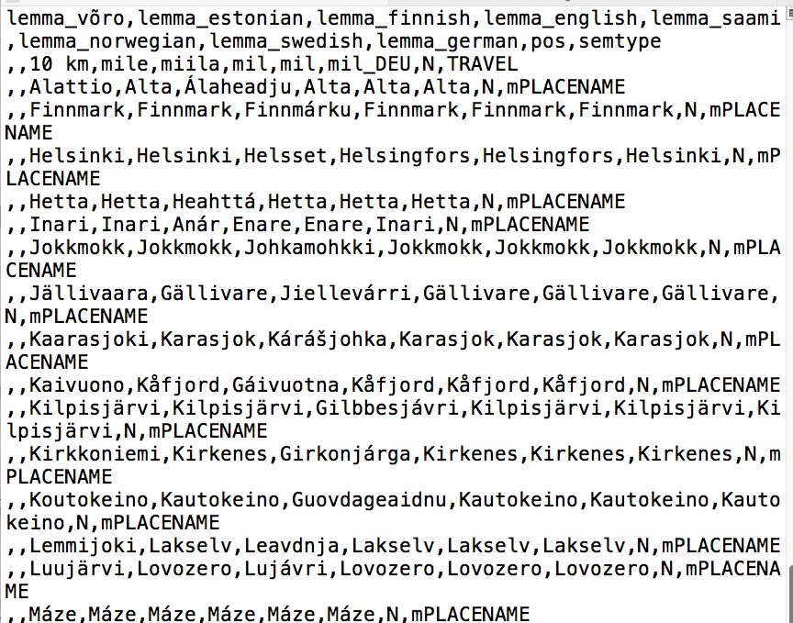
CSV and input
Notes:
Input and editing involve collaboration between the language community and the linguist.
Comma separated values might be straight forward, but they might also be too simple

Slide 10
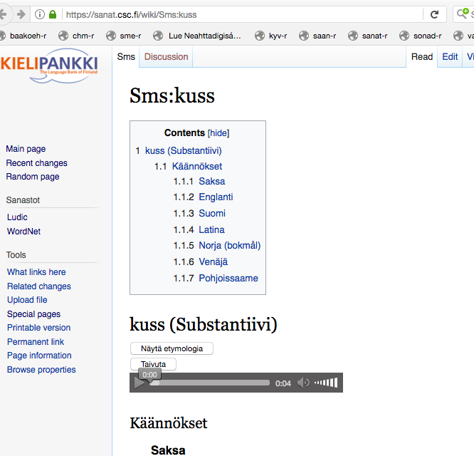
WikiMedia at CSC
Notes:
Finding a language-independent open-source input method requires some creativity.
Avoiding too much creativity on the part of the enlightened crowd can also be a problem.
One solution is WikiMedia.

Slide 11
Language pair resources
Source types
  Fieldwork research dictionaries
  ICALL translation pairs
  Access to minority-language literature
Languages with multiple targets
  10–20
Shared pivots
  Finnish, Russian, Norwegian, German, Hungarian, English
Notes:
Classify by source
Fieldwork research dictionaries
ICALL translation practice pairs
Access for minority language

Slide 12
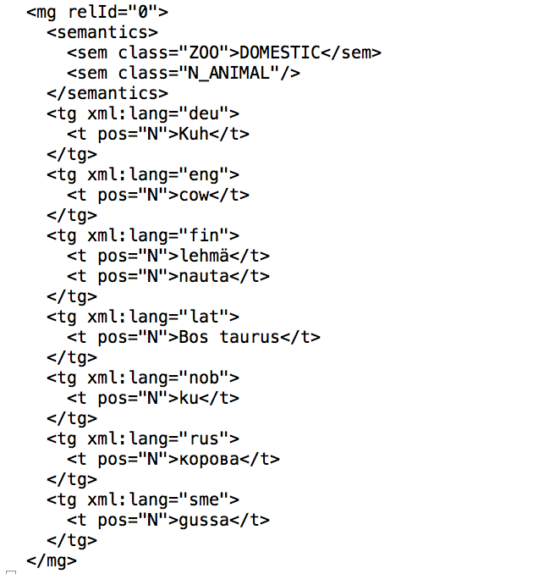
Multi-lingual dictionaries
Notes:
Some languages already have a number of translations for some of their vocabulary.
Wouldn’t it be wonderful if this information could be extended for the facilitation of other languages.

Slide 13
Shared linguistic diversity
Beyond synchronized Xml-WikiMedia dictionary editing
Utilization of what is already available
Enhanced shared translation for multilingual facilitation
Notes:
Synchronized dictionary editing for independent input
Applying what is already known
Merging of multiple translation languages into shared entries.

Slide 14
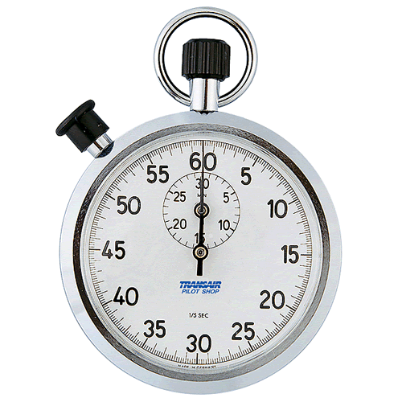
Time’s Up!
About your speaker:
  Name: Jack Rueter
  Institution: University of Helsinki
  Social Media: fb: Jack Michael Rueter
  Quick bio: Grew up in Seattle area, two university degrees in Helsinki. Uralic language morphology. Kone Foundation Language Programme writer. two language facilitation projects. Inari, Saransk, Tartu, Syktyvkar

